Slide 1
Operating System
Lecture #1
Introduction to OS

Slide 2
Objectives
To understand what Operating System is?
What does it do?
Why do we need it?
Modes (Supervisor and User)

Slide 3
Introduction
A program that acts as an intermediate/ interface between a user of a computer and the computer hardware.
Operating system goals:
Execute user programs and make problem solving easier.
Make the computer system convenient to use
Efficiently use available resources

Slide 4
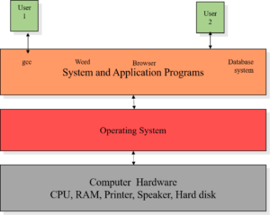
Four components of Computer System

Slide 5
What does OS do?
Hardware understands binary language.
Instructions must be passed in binary language only.
OS acts as an translator which converts commands given to binary language.

Slide 6
Why we need OS?
Let’s suppose you want to add two numbers: c=a+b;
No OS If you are working on MC6800 hardware then the instructions will be:
LDAA $80 – Loading the number at memory location 80 LDAB $81 – Loading the number at memory location 81 ADDB – Adding these two numbers STAA $55 – Storing the sum to memory location 55 But the moment you hardware changes, for example, say to 8086 or 8088, all the above instructions will change,
With OS Use any High Level Language like C. Write c=a+b; The underlying hardware does not matter because OS takes care of conversion.
Infact this is what we always do. Have we ever bothered what hardware are we using.
Our focus is just writing the code correctly in C, C++, Python etc.

Slide 7
Modes of OS
User mode
Supervisor mode/Kernel mode/System mode
Bit called mode bit is added to hardware to indicate the mode.
For kernel mode : 0 (Task executed on behalf of OS)
For user mode : 1 (Task executed on behalf of User application)

Slide 8
Dual Mode Operation
Hardware starts in kernel mode at system boot time.
When OS load and execute user applications then switch mode to User mode.
If any interrupt/privileged instructions occurs it will shift back to kernel mode.
Examples of privileged instructions:
I/O management, timer management, interrupt management.

Slide 9
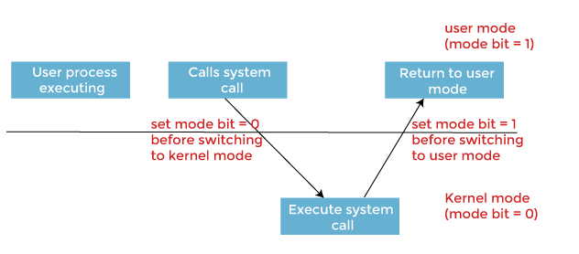
Dual Mode Operation

Slide 10
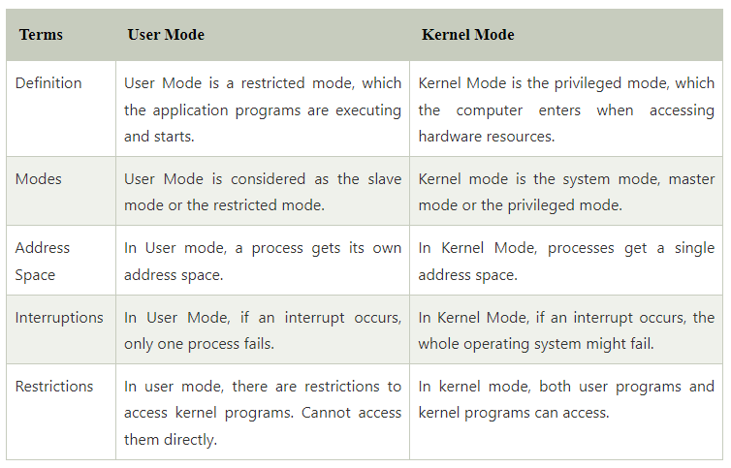

Slide 11
Need of Dual Mode Operation
Operating System needs to function in the dual mode because the Kernel Level programs perform all the bottom level functions of the OS like process management, Memory management, etc.
If the user alters these, then this can cause an entire system failure. So, for specifying the access to the users only to the tasks of their use, Dual Mode is necessary for an Operating system.

Slide 12
Key Points to remember
OS is mediator between you and your device.
Privileged actions can be performed by only kernel mode.
Before switching the mode, mode bits should be set accordingly.

Slide 13
Questions?
What is difference between OS and kernel?
When OS loads, what will be the mode of the system?

